Slide 1













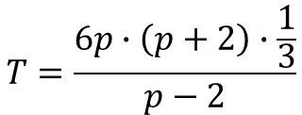

Opgave 14
Je moet vereenvoudigen
$$M=\frac{5}{t}−3t$$
$$∙\frac{t}{t}$$
$$=\frac{5−3∙t^{2}}{t}$$
dus
$$M=\frac{5−3∙t^{2}}{t}$$
$$T=\frac{6p∙\left(p+2\right)∙\frac{1}{3}}{p−2}$$
$$T=\frac{2p^{2}+4p}{p−2}$$
$$=\frac{2p∙\left(p+2\right)}{p−2}$$
$$=\frac{2p^{2}+4p}{p−2}$$
dus
$$F=\frac{0,05p^{2}}{p}+\frac{4p}{p}−\frac{5}{p}$$
$$=0,05p+4−\frac{5}{p}$$
dus
$$F=0,05p+4−\frac{5}{p}$$

