Slide 1
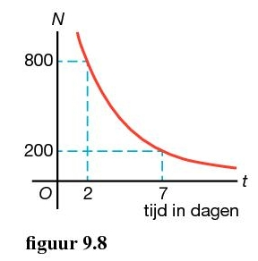
Opgave 51
$$5$$
Stel :
$$N=b∙g^{t}$$
door de punten
$$\left(2, 800\right)$$
$$en \left(7, 200\right)$$
De groeifactor per $5$ dagen is:
$$g_{5 dagen}=$$
$$\frac{200}{800}$$
$$=0,25$$
$$g_{dag}={\left(0,25\right)}^{\frac{1}{5}}$$
$$=0,7578…$$
Dus
$$N=b∙{\left(0,7578…\right)}^{t}$$
geeft
$$800=b∙{\left(0,7578…\right)}^{2}$$
$$t=2 en N=800$$
$$b=\frac{800}{{\left(0,7578…\right)}^{2}}$$
$$≈1400$$
of
$$=1392,88…$$
Formule:
$$N=1400∙{0,758}^{t}$$

