Slide 1
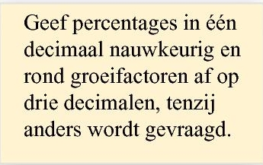
Opgave 25
$$g_{kwartier}=$$
$$1,12$$
(groeifactor per kwartier)
$$g_{uur}=$$
$${1,12}^{4}$$
$$=1,573519…$$
(groeifactor per uur)
De toename per uur is
$$57,4\%$$
$$g_{kwartier}=$$
$$1,12$$
$$g_{5 uur}=$$
$${1,12}^{20}$$
$$=9,64629…$$
$$g_{kwartier}=$$
$$1,12$$
De toename per $5$ uur is
$$864,6\%$$
$$g_{5 min}=$$
$${1,12}^{\frac{1}{3}}$$
$$=1,03849…$$
De toename per $5$ minuten is
$$3,8\%$$

