Slide 1
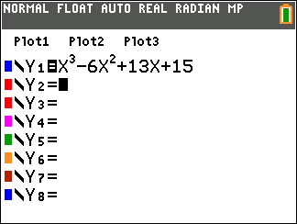
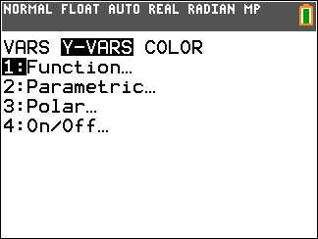
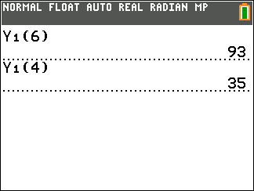
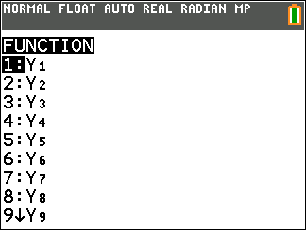
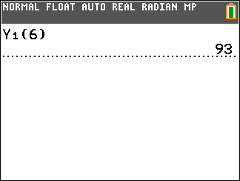
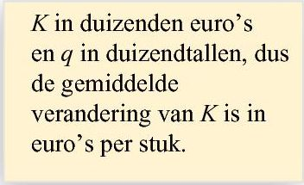
Opgave 44
Voer in:
$$Y_{1}=x^{3}−6x^{2}+13x+15$$
$$Op \left[4,6\right] is \frac{∆K}{∆q}=$$
$$\frac{93−35}{6−4}$$
$$=\frac{58}{2}=29$$
euro per stuk
$$Op \left[2,5\right] is \frac{∆K}{∆q}=$$
$$\frac{55−25}{5−2}$$
$$=\frac{30}{3}=10$$
euro per stuk

Slide 2
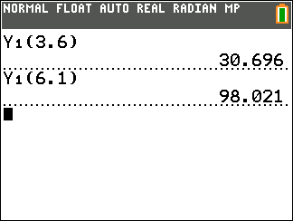
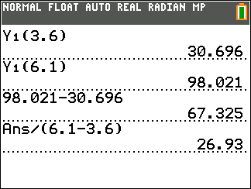
Opgave 44
Interval
$$[3,6 ;6,1]$$
$$Op \left[3,6 ;6,1\right] is \frac{∆K}{∆q}=$$
$$\frac{98,021−30,696}{6,1−3,6}$$
$$=26,93$$
De gemiddelde toename van de kosten is $26,93$ euro per stuk

