Slide 1








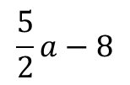



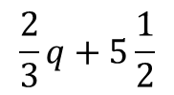
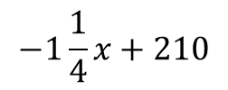



Opgave 59
$$15x+12y=2520$$
$$3p−2q=16\frac{1}{2}$$
$$5a−2b=16$$
$$3p=16\frac{1}{2}+2q$$
$$−2b=16−5a$$
$$12y=2520−15x$$
$$b=−8+\frac{5}{2}a$$
$$y=210−\frac{15}{12}x$$
$$p=5\frac{1}{2}+\frac{2}{3}q$$
$$\frac{2}{3}q+5\frac{1}{2}$$
$$\frac{5}{2}a−8$$
$$b=$$
$$y=210−1\frac{1}{4}x$$
$$p=$$
$$b=2\frac{1}{2}a−8$$
$$−1\frac{1}{4}x+210$$
$$y=$$

