Slide 1
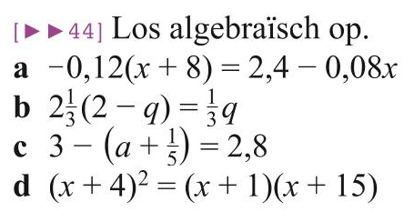
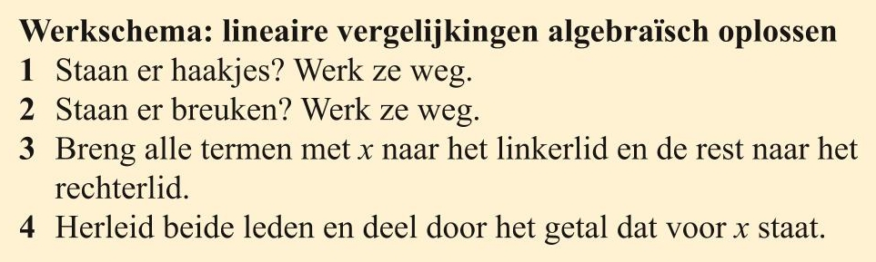







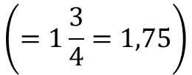










Opgave 41
a) $−0,12\left(x+8\right)=2,4−0,08x$
b) $2\frac{1}{3}\left(2−q\right)=\frac{1}{3}q$
c) $3−\left(a+\frac{1}{5}\right)=2,8$
keer 3
$$−0,12x−0,96=2,4−0,08x$$
$$7\left(2−q\right)=q$$
$$3−a−\frac{1}{5}=2,8$$
$$−0,12x+0,08x=2,4+0,96$$
$$14−7q=q$$
$$−a=2,8−3+\frac{1}{5}$$
$$−0,04x=3,36$$
$$−7q−q=−14$$
$$x=\frac{3,36}{−0,04}$$
$$−8q=−14$$
$$−a=0$$
$$q=\frac{−14}{−8}$$
$$a=0$$
$$x=−84$$
$$q=\frac{7}{4}$$
$$\left(=1\frac{3}{4}=1,75\right)$$

Slide 2









Opgave 41
d)
$${\left(x+4\right)}^{2}=\left(x+1\right)\left(x+15\right)$$
$$\left(x+4\right)\left(x+4\right)=\left(x+1\right)\left(x+15\right)$$
$$x^{2}+4x$$
$$+ 4x+16=$$
$$x^{2}+15x+x+15$$
$$x^{2}+8x+16=x^{2}+16x+15$$
( haal van beide leden $x^{2}$ af )
$$8x−16x=15−16$$
$$−8x=−1$$
$$x=\frac{−1}{−8}$$
$$\frac{ 1 }{ 8 }$$

