Slide 1
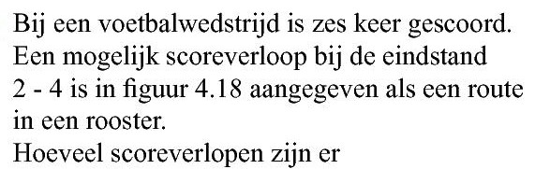
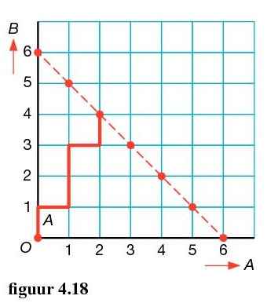



















Opgave 69
Van de zes doelpunten heeft A er twee gescoord
aantal
$$=\left(\begin{aligned}6 \\ 2\end{aligned}\right)$$
$$=15$$
aantal
$$=\left(\begin{aligned}6 \\ 3\end{aligned}\right)$$
$$=20$$
aantal
$$=\left(\begin{aligned}6 \\ 5\end{aligned}\right)$$
$$=6$$
aantal
$$=\left(\begin{aligned}6 \\ 0\end{aligned}\right)$$
$$+\left(\begin{aligned}6 \\ 1\end{aligned}\right)$$
$$+\left(\begin{aligned}6 \\ 2\end{aligned}\right)$$
$$+\left(\begin{aligned}6 \\ 3\end{aligned}\right)$$
$$+\left(\begin{aligned}6 \\ 4\end{aligned}\right)$$
$$+\left(\begin{aligned}6 \\ 5\end{aligned}\right)$$
$$+\left(\begin{aligned}6 \\ 6\end{aligned}\right)$$
$$=64$$
of korter
$$2∙2∙2∙2∙2∙2=$$
$$2^{6}=64$$
$$\left(\begin{aligned}\text{een} \text{doelpunt} \text{wordt} \text{gescoord} \text{door} \text{team} \text{A} \text{of} \text{team} \text{B}\text{. } \\ \text{Per} \text{doelpunt} \text{dus} \text{twee} \text{mogelijkheden}\end{aligned}\right)$$
(bv. Team A scoorde $0,1,2,3,4,5 of 6$ doelpunten)

