Slide 1
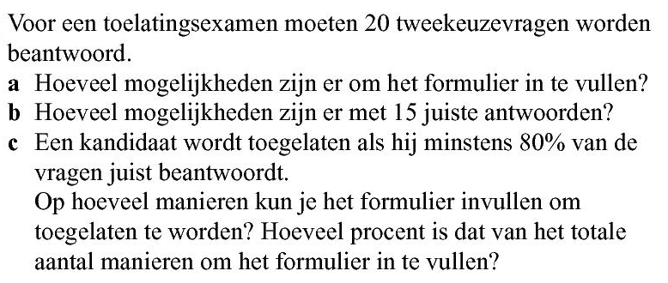






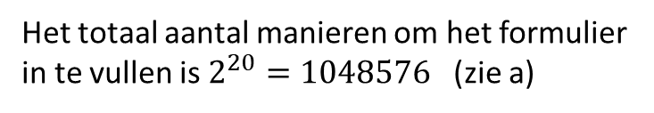







Opgave 60
a) aantal
$$=2^{20}$$
$$=1048576$$
b) aantal
$$=\left(\begin{aligned}20 \\ 15\end{aligned}\right)$$
$$=15504$$
16, 17, 18, 19, 20
c)
$$80\% van 20 :$$
$$0,8∙20=16$$
, dus de kandidaat moet minstens 16 vragen juist beantwoorden.
Het totaal aantal manieren om het formulier
in te vullen is $2^{20}=1048576$ (zie a)
aantal
$$=\left(\begin{aligned}20 \\ 16\end{aligned}\right)$$
$$+\left(\begin{aligned}20 \\ 17\end{aligned}\right)$$
$$+\left(\begin{aligned}20 \\ 18\end{aligned}\right)$$
$$+\left(\begin{aligned}20 \\ 19\end{aligned}\right)$$
$$+\left(\begin{aligned}20 \\ 20\end{aligned}\right)$$
$$=4845+1140+190+20+1$$
$$\frac{6169}{1048576}∙100\%≈0,6\%$$
$$=6196$$

