Slide 1
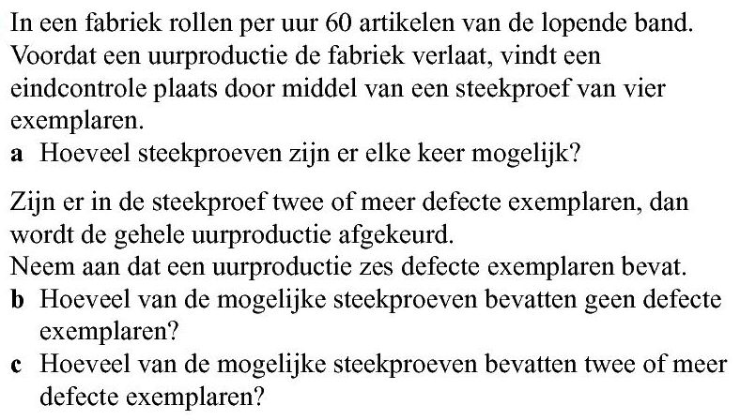













Opgave 53
a) aantal
$$=\left(\begin{aligned}60 \\ 4\end{aligned}\right)$$
$$=487635$$
$$( 60 nCr 4)$$
defecte exemplaren : $6$
werkende exemplaren:
$$60−6=54$$
b) aantal
$$=\left(\begin{aligned}54 \\ 4\end{aligned}\right)$$
$$=316251$$
$$( 54 nCr 4)$$
c) Twee of meer (van de 4) betekent 2, 3 of 4
aantal
$$=\left(\begin{aligned}6 \\ 2\end{aligned}\right)∙\left(\begin{aligned}54 \\ 2\end{aligned}\right)$$
$$+\left(\begin{aligned}6 \\ 3\end{aligned}\right)∙\left(\begin{aligned}54 \\ 1\end{aligned}\right)$$
$$+\left(\begin{aligned}6 \\ 4\end{aligned}\right)∙\left(\begin{aligned}54 \\ 0\end{aligned}\right)$$
$$=15∙1431+20∙54+15∙1$$
$$=22560$$

