Slide 1
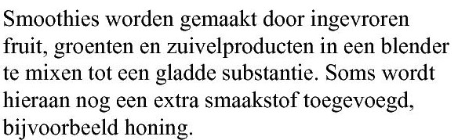
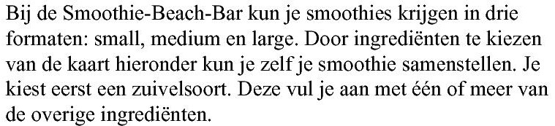
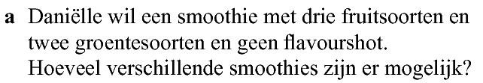
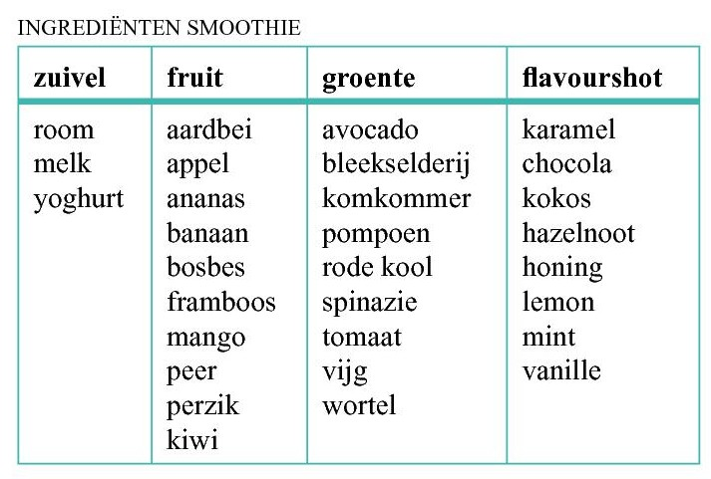









Opgave 52
aantal
$$3∙$$
$$\left(\begin{aligned}10 \\ 3\end{aligned}\right)∙$$
$$\left(\begin{aligned}9 \\ 2\end{aligned}\right)$$
$$=3∙3∙120∙36=38880$$
$$=3∙$$
groenten
fruit
zuivel
$$3$$
$$10$$
$$9$$
$$8$$
formaat

Slide 2
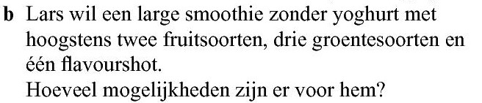









Opgave 52
hoogstens twee fruitsoorten betekent $0, 1 of 2$ fruitsoorten.
aantal
$$=1∙2∙\left(\begin{aligned}10 \\ 0\end{aligned}\right)∙\left(\begin{aligned}9 \\ 3\end{aligned}\right)∙8$$
$$+1∙2∙\left(\begin{aligned}10 \\ 1\end{aligned}\right)∙\left(\begin{aligned}9 \\ 3\end{aligned}\right)∙8$$
$$+1∙2∙\left(\begin{aligned}10 \\ 2\end{aligned}\right)∙\left(\begin{aligned}9 \\ 3\end{aligned}\right)∙8$$
(geen fruitsoort)
(één fruitsoort)
(twee fruitsoorten)
$$=1∙2∙1∙84∙8+1∙2∙10∙84∙8+1∙2∙45∙84∙8$$
$$3$$
$$10$$
$$9$$
$$8$$
$$=1344+13440+60480$$
$$=75264$$

Slide 3
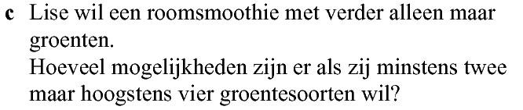





Opgave 52
minstens $2$ maar hoogstens $4$ groentesoorten betekent $2, 3 of 4$
aantal
$$=3∙1∙\left(\begin{aligned}9 \\ 2\end{aligned}\right)$$
$$+3∙1∙\left(\begin{aligned}9 \\ 3\end{aligned}\right)$$
$$+3∙1∙\left(\begin{aligned}9 \\ 4\end{aligned}\right)$$
(2 groenten)
(3 groenten)
(4 groenten)
$$=3∙36+3∙84+3∙126$$
$$3$$
$$10$$
$$9$$
$$8$$
$$=738$$

