Slide 1
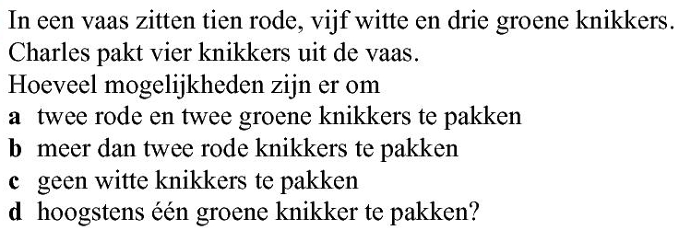














Opgave 49
a) aantal
$$=\left(\begin{aligned}10 \\ 2\end{aligned}\right)$$
$$∙\left(\begin{aligned}3 \\ 2\end{aligned}\right)$$
$$=45∙3=135$$
c) aantal
$$=\left(\begin{aligned}13 \\ 4\end{aligned}\right)$$
$$=715$$
b) Meer dan twee rode betekent 3 of 4 rode
d) Hoogstens één groene betekent geen of één groen
aantal
$$=\left(\begin{aligned}10 \\ 3\end{aligned}\right)$$
$$∙\left(\begin{aligned}8 \\ 1\end{aligned}\right)$$
$$+\left(\begin{aligned}10 \\ 4\end{aligned}\right)∙\left(\begin{aligned}8 \\ 0\end{aligned}\right)$$
aantal
$$=\left(\begin{aligned}3 \\ 0\end{aligned}\right)∙\left(\begin{aligned}15 \\ 4\end{aligned}\right)$$
$$+\left(\begin{aligned}3 \\ 1\end{aligned}\right)∙\left(\begin{aligned}15 \\ 3\end{aligned}\right)$$
$$=120∙8+210∙1$$
$$=1365+1365$$
$$=1170$$
$$=2730$$

