Slide 1
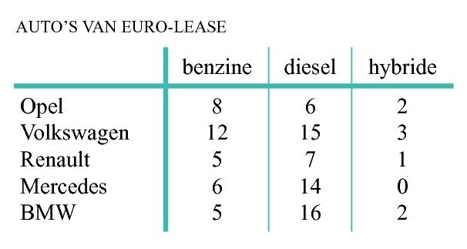
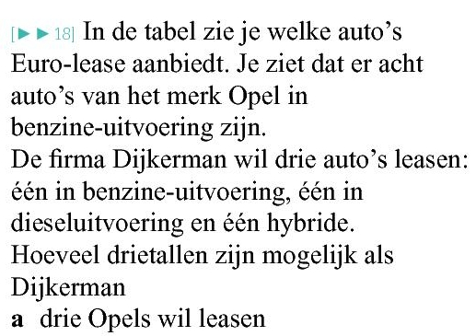










Opgave 14
aantal =
$$8∙6∙2=96$$
aantal =
$$8∙6∙2+12∙15∙3+5∙7∙1+6∙14∙0+5∙16∙2$$
aantal =
$$12∙16∙2=384$$
$$=96+540+35+0+160$$
aantal =
$$8∙6∙1$$
$$+ 8∙7∙2$$
$$+ 5∙6∙2$$
$$=831$$
$$=48+112+60$$
$$=220$$

