Slide 1
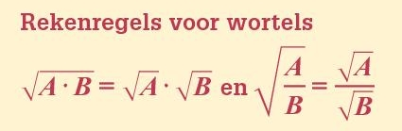







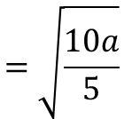









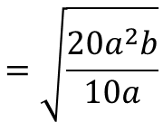


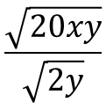
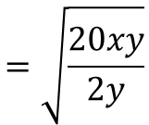

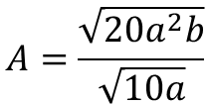

Opgave 33
Herleid
$$\frac{\sqrt{20xy}}{\sqrt{2y}}$$
$$=\sqrt{\frac{20xy}{2y}}$$
a)
$$\sqrt{3a}∙\sqrt{5b}$$
$$=\sqrt{15ab}$$
f)
$$=\sqrt{10x}$$
$$\frac{\sqrt{10a}}{\sqrt{5}}$$
$$=\sqrt{\frac{10a}{5}}$$
c)
$$=\sqrt{2a}$$
Opgave 34
a)
$$A=\sqrt{5a}∙\sqrt{6b}$$
$$=\sqrt{30ab}$$
$$=\sqrt{30}∙\sqrt{ab}$$
$$≈5,48\sqrt{ab}$$
$$dus A≈5,48\sqrt{ab}$$
c)
$$A=6\sqrt{3a}∙\sqrt{7b}$$
$$=6\sqrt{21ab}$$
$$=6\sqrt{21}∙\sqrt{ab}$$
$$≈27,50\sqrt{ab}$$
$$dus A≈27,50\sqrt{ab}$$
$$A=\frac{\sqrt{20a^{2}b}}{\sqrt{10a}}$$
$$=\sqrt{\frac{20a^{2}b}{10a}}$$
f)
$$=\sqrt{2ab}$$
$$=\sqrt{2}∙\sqrt{ab}$$
$$≈1,41\sqrt{ab}$$
$$dus A≈1,41\sqrt{ab}$$

